Slide 1

Minimizing angular Error in labeled Graphs

Slide 2
Graphs
Labeled Graph
Directed Graph (Digraph), no edges to oneself
Graph with angle orientation for each vertex
=> directed angular graph (DAG)

Slide 3
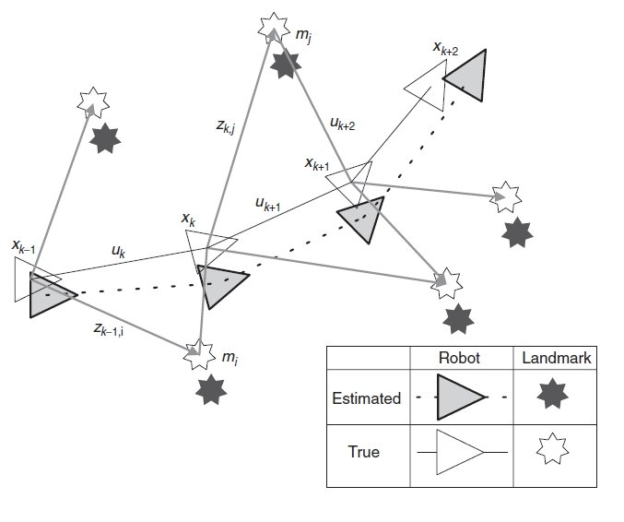
SLAM
"SLAM is a process by which a mobile robot can build a map of an environment and at the same time use this map to deduce its location.“
Simultaneous localization and mapping
Cumulative error

Slide 4
Dual Population Coding
Navigation model by Tristan Baumann
Graph based spatial representation
Estimating the global reference direction at each point

Slide 5
Direction Drift

Slide 6
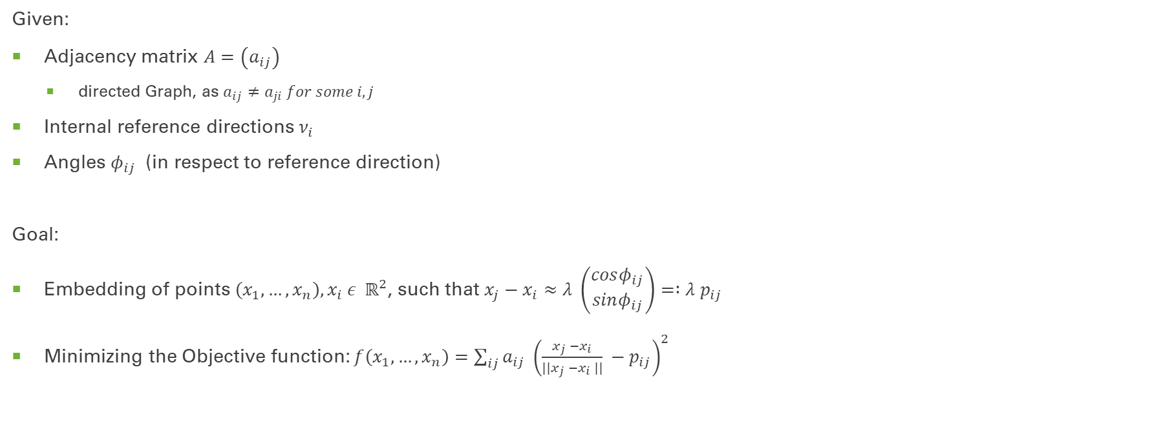
Problem
Given:
Adjacency matrix $A=\left(a_{ij}\right)$
directed Graph, as $a_{ij}≠a_{ji} for some i,j$
Internal reference directions $ν_{i}$
Angles $φ_{ij}$ (in respect to reference direction)
Goal:
Embedding of points $\left(x_{1}, …, x_{n}\right), x_{i} ε { ℝ}^{2}$, such that $x_{j}−x_{i}≈λ \left(\begin{aligned}cosφ_{ij} \\ sinφ_{ij}\end{aligned}\right)= :λ p_{ij}$
Minimizing the Objective function: $f\left(x_{1},…,x_{n}\right)=\sum_{ij}{a_{ij} {\left(\frac{x_{j} −x_{i}}{||x_{j} −x_{i} ||} −p_{ij}\right)}^{2}}$

Slide 7
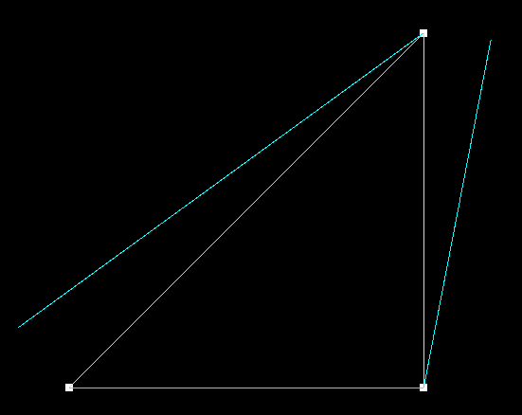

Problem
Embedding of points $\left(x_{1}, …, x_{n}\right), x_{i} ε { ℝ}^{2}$, such that $x_{j}−x_{i}≈λ \left(\begin{aligned}cosφ_{ij} \\ sinφ_{ij}\end{aligned}\right)= :λ p_{ij}$
Minimization problem: $f\left(x_{1},…,x_{n}\right)=\sum_{ij}{a_{ij} {\left(\frac{x_{j} −x_{i}}{||x_{j} −x_{i} ||} −p_{ij}\right)}^{2}}$

Slide 8
Problem
3
Embedding of points $\left(x_{1}, …, x_{n}\right), x_{i} ε { ℝ}^{2}$, such that $x_{j}−x_{i}≈λ \left(\begin{aligned}cosφ_{ij} \\ sinφ_{ij}\end{aligned}\right)= :λ p_{ij}$
Minimization problem: $f\left(x_{1},…,x_{n}\right)=\sum_{ij}{a_{ij} {\left(\frac{x_{j} −x_{i}}{||x_{j} −x_{i} ||} −p_{ij}\right)}^{2}}$
1
2

Slide 9

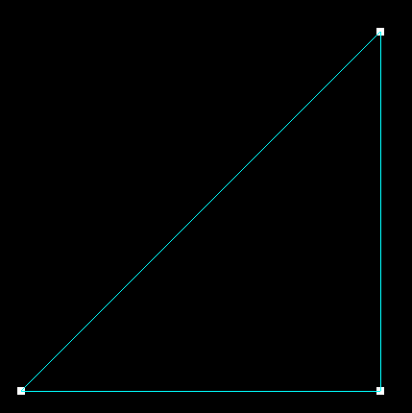
Problem
3
Embedding of points $\left(x_{1}, …, x_{n}\right), x_{i} ε { ℝ}^{2}$, such that $x_{j}−x_{i}≈λ \left(\begin{aligned}cosφ_{ij} \\ sinφ_{ij}\end{aligned}\right)= :λ p_{ij}$
Minimization problem: $f\left(x_{1},…,x_{n}\right)=\sum_{ij}{a_{ij} {\left(\frac{x_{j} −x_{i}}{||x_{j} −x_{i} ||} −p_{ij}\right)}^{2}}$
1
2

Slide 10
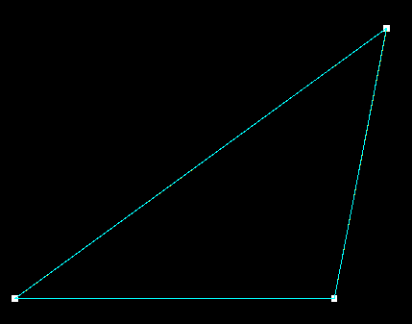
Problem
3
Embedding of points $\left(x_{1}, …, x_{n}\right), x_{i} ε { ℝ}^{2}$, such that $x_{j}−x_{i}≈λ \left(\begin{aligned}cosφ_{ij} \\ sinφ_{ij}\end{aligned}\right)= :λ p_{ij}$
Minimization problem: $f\left(x_{1},…,x_{n}\right)=\sum_{ij}{a_{ij} {\left(\frac{x_{j} −x_{i}}{||x_{j} −x_{i} ||} −p_{ij}\right)}^{2}}$
1
2

Slide 11
MDS – Multidimensional Scaling
Classical MDS:
"Given a distance matrix with the distances between each pair of objects in a set [...] an MDS algorithm places each object into […] [this] space such that the between-object distances are preserved as well as possible."

Slide 12

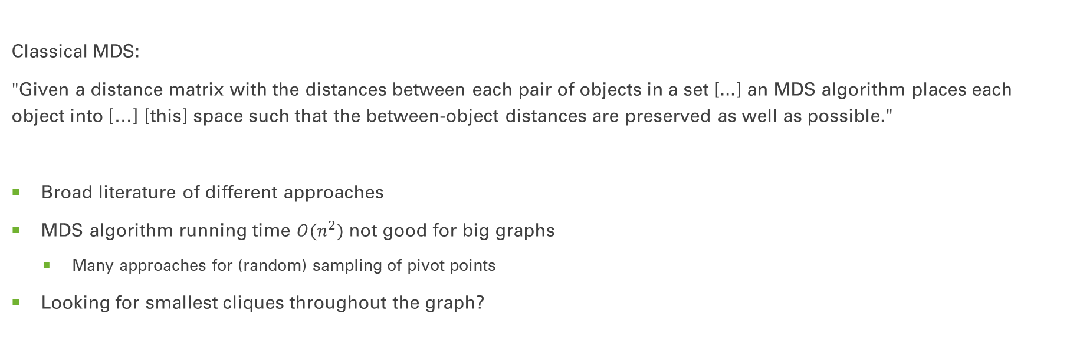
MDS – Multidimensional Scaling
Classical MDS:
"Given a distance matrix with the distances between each pair of objects in a set [...] an MDS algorithm places each object into […] [this] space such that the between-object distances are preserved as well as possible."
Broad literature of different approaches
MDS algorithm running time $O(n^{2})$ not good for big graphs
Many approaches for (random) sampling of pivot points
Looking for smallest cliques throughout the graph?

Slide 13
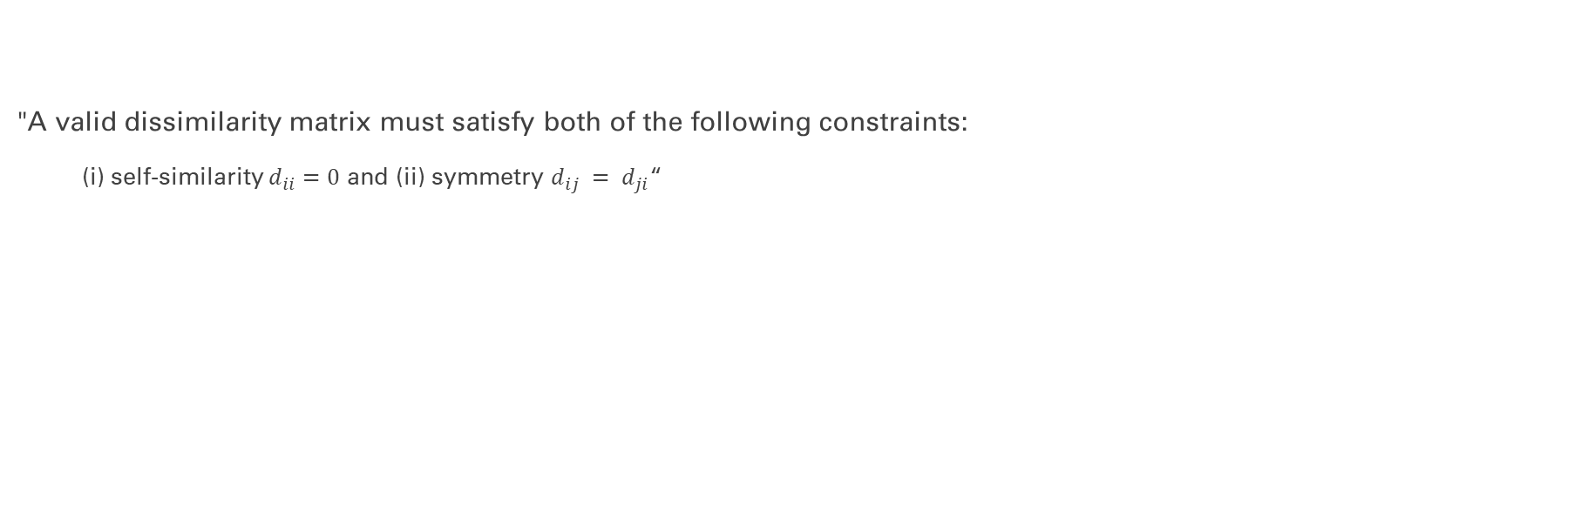
MDS – Multidimensional Scaling
"A valid dissimilarity matrix must satisfy both of the following constraints:
(i) self-similarity $d_{ii}=0$ and (ii) symmetry $d_{ij} = d_{ji}$“

Slide 14
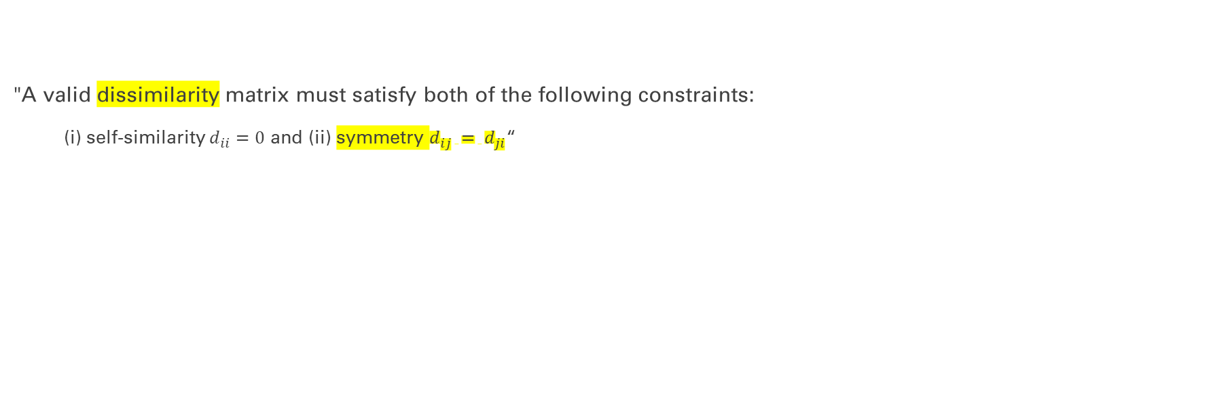
MDS – Multidimensional Scaling
"A valid dissimilarity matrix must satisfy both of the following constraints:
(i) self-similarity $d_{ii}=0$ and (ii) symmetry $d_{ij} = d_{ji}$“
difference of angles, not distances
What are the implications for a classical MDS in our case?

Slide 15
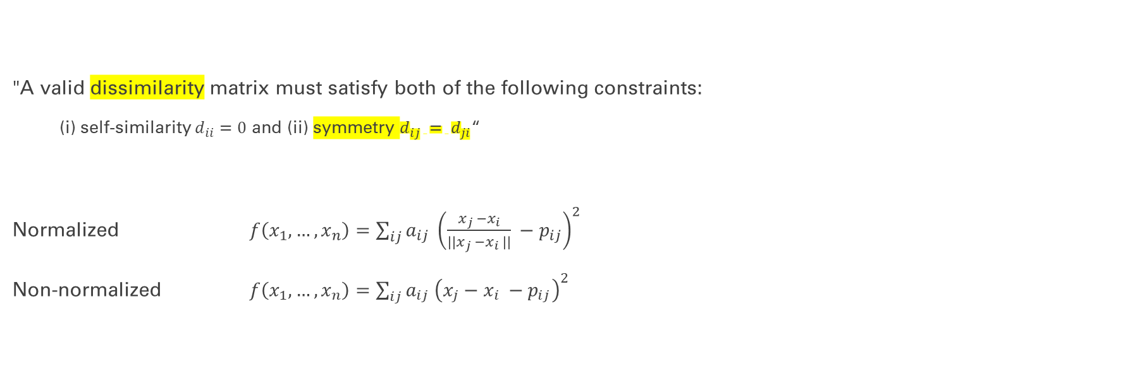
MDS – Multidimensional Scaling
"A valid dissimilarity matrix must satisfy both of the following constraints:
(i) self-similarity $d_{ii}=0$ and (ii) symmetry $d_{ij} = d_{ji}$“
Normalized $f\left(x_{1},…,x_{n}\right)=\sum_{ij}{a_{ij} {\left(\frac{x_{j} −x_{i}}{||x_{j} −x_{i} ||} −p_{ij}\right)}^{2}}$
Non-normalized $f\left(x_{1},…,x_{n}\right)=\sum_{ij}{a_{ij} {\left(x_{j}−x_{i} −p_{ij}\right)}^{2}}$
difference of angles, not distances
What are the implications for a classical MDS in our case?

Slide 16
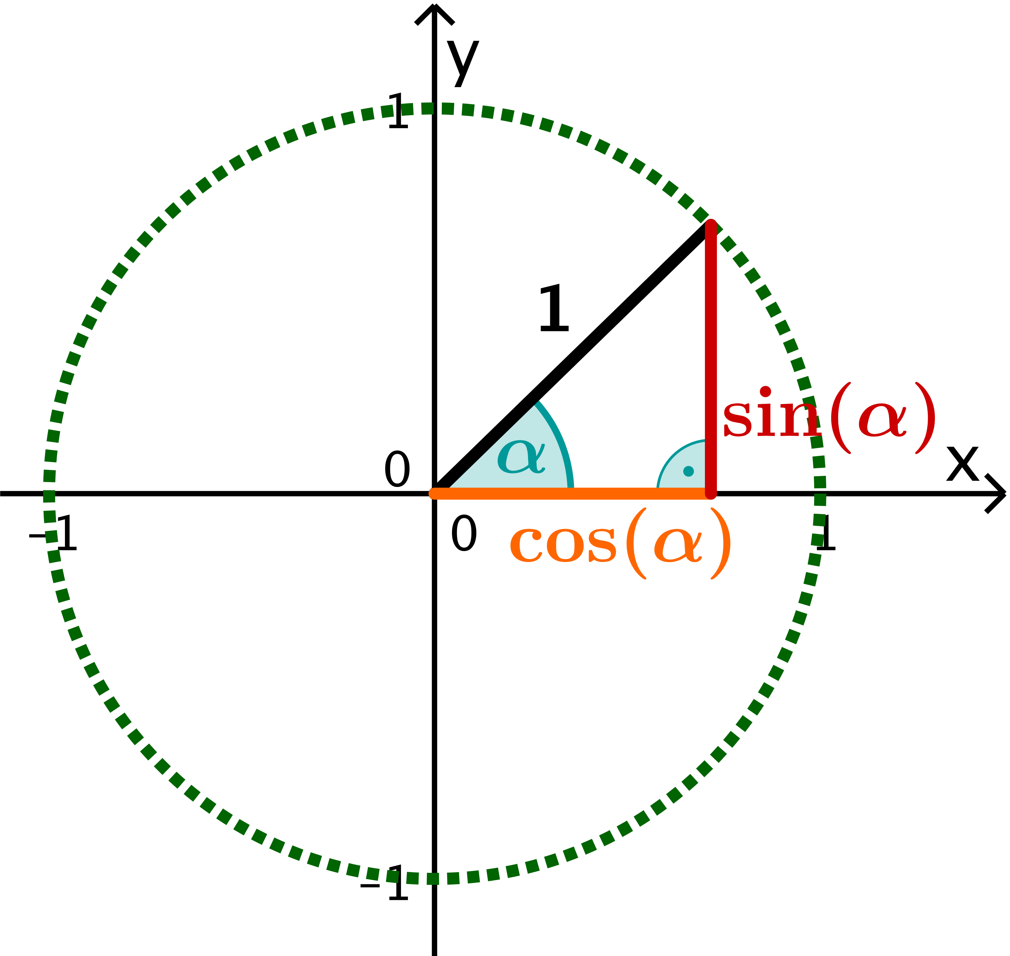


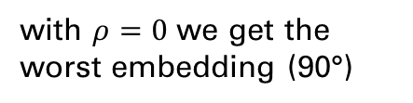
Measurement
$${\left(\frac{x_{j} −x_{i}}{||x_{j} −x_{i} ||} −p_{ij}\right)}^{2} \\ ={\left(x_{ij}−p_{ij}\right)}^{2} \\ = x_{ij}^{2}+p_{ij}^{2}−2\left(x_{ij}∘p_{ij}\right) \\ =1+1−2\left(x_{ij}∘p_{ij}\right) \\ =2−2∗ρ, mit ρ ε [−1,1]$$
$$f\left(x_{1},…,x_{n}\right)=\sum_{ij}{a_{ij} {\left(\frac{x_{j} −x_{i}}{||x_{j} −x_{i} ||} −p_{ij}\right)}^{2}}$$
with $ρ=0$ we get the worst embedding (90°)

Slide 17

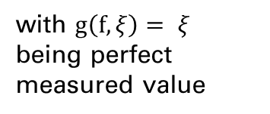
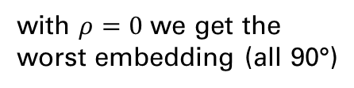
Measurement
$${\left(\frac{x_{j} −x_{i}}{||x_{j} −x_{i} ||} −p_{ij}\right)}^{2} \\ ={\left(x_{ij}−p_{ij}\right)}^{2} \\ = x_{ij}^{2}+p_{ij}^{2}−2\left(x_{ij}∘p_{ij}\right) \\ =1+1−2\left(x_{ij}∘p_{ij}\right) \\ =2−2∗ρ, mit ρ ε [−1,1]$$
$$f\left(x_{1},…,x_{n}\right)=\sum_{ij}{a_{ij} {\left(\frac{x_{j} −x_{i}}{||x_{j} −x_{i} ||} −p_{ij}\right)}^{2}}$$
$$g\left(f\right)=\frac{f\left(x_{1},…,x_{n}\right)}{\sum_{ij}{a_{ij}}} ε \left[0,4\right]$$
$$g\left(f,ξ\right)=| ξ ∗( \frac{f\left(x_{1},…,x_{n}\right)}{2 ∗ \sum_{ij}{a_{ij}}} −1)| ε [0, ξ]$$
with $ρ=0$ we get the worst embedding (all 90°)
with $g\left(f,ξ\right)= ξ$ being perfect measured value

Slide 18
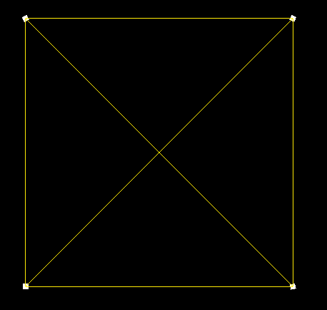
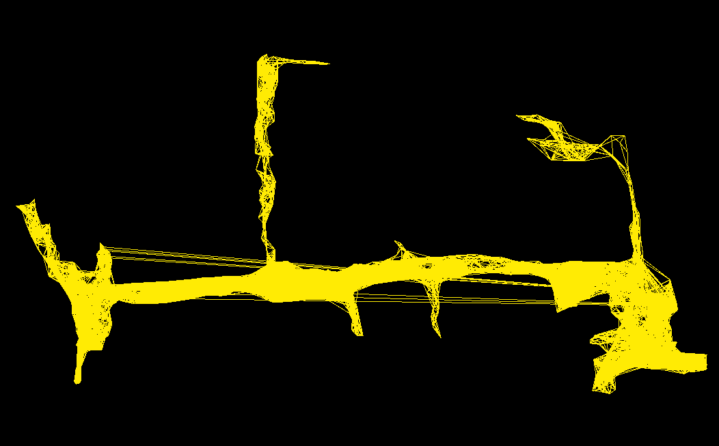
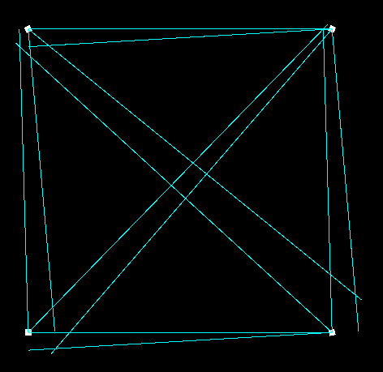

Slide 19
